Slide 1
Advanced Computer Architecture
Lecture 1 – Introduction,
A simple RISC processor
Yasir Javed
Abasyn University Islamabad Campus
Most of course slides from CS152 and CS252 UC Berkeley

Slide 2

What is Computer Architecture?
Application
Gap too large to bridge in one step
(but there are exceptions, e.g. magnetic compass)
Physics
In its broadest definition, computer architecture is the design of the abstraction layers that allow us to implement information processing applications efficiently using available manufacturing technologies.

Slide 3

Abstraction Layers in Modern Systems
Application
Algorithm
Programming Language
Operating System/Virtual Machines
Instruction Set Architecture (ISA)
Comp. Arch
Microarchitecture
Gates/Register-Transfer Level (RTL)
Circuits
Devices
Physics

Slide 4
Architecture continually changing
Applications suggest how to improve technology, provide revenue to fund development
Improved technologies make new applications possible
Applications
Technology
Cost of software development makes compatibility a major force in market
Compatibility

Slide 5
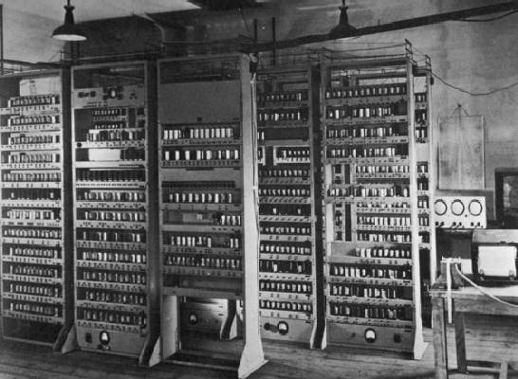
Computing Devices Then…
EDSAC, University of Cambridge, UK, 1949

Slide 6


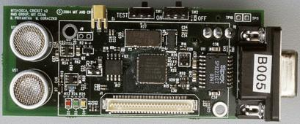
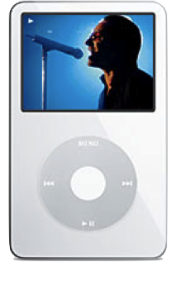
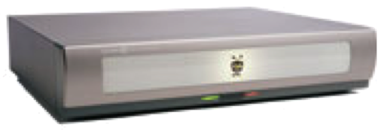

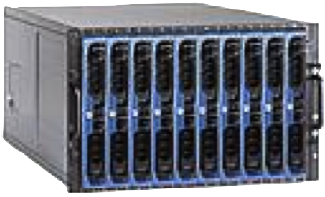




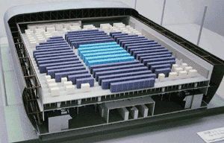
Computing Devices Now
Sensor Nets
Cameras
Games
Set-top boxes
Media Players
Laptops
Servers
Routers
Robots
Smart phones
Automobiles
Supercomputers

Slide 7
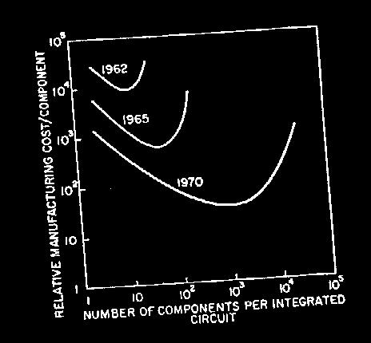
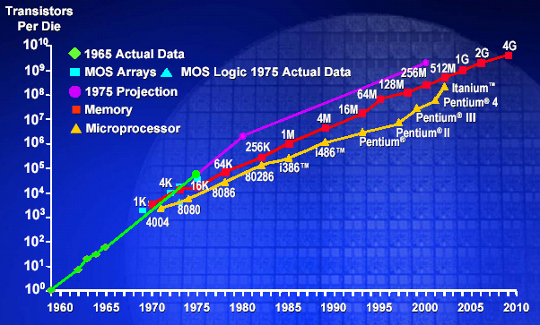
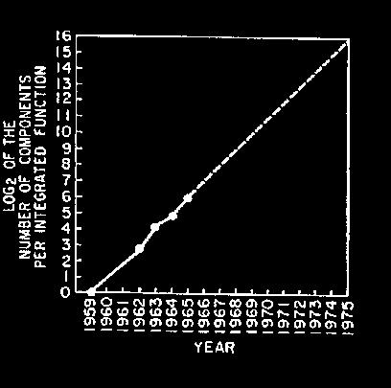
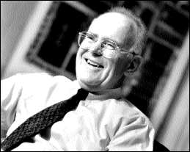
Moore’s Law
“Cramming More Components onto Integrated Circuits”
  Gordon Moore, Electronics, 1965
# on transistors on cost-effective integrated circuit double every 18 months

Slide 8
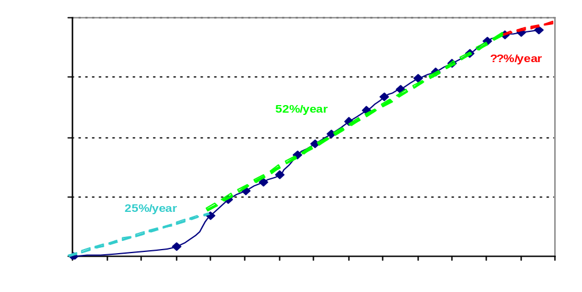
Uniprocessor Performance
From Hennessy and Patterson, Computer Architecture: A Quantitative Approach, 4th edition, October, 2006
What happened????
VAX : 25%/year 1978 to 1986
RISC + x86: 52%/year 1986 to 2002
RISC + x86: ??%/year 2002 to present

Slide 9
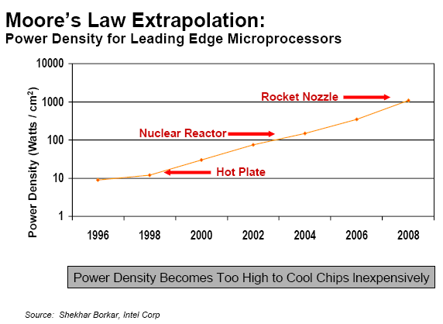
Limiting Force: Power Density

Slide 10
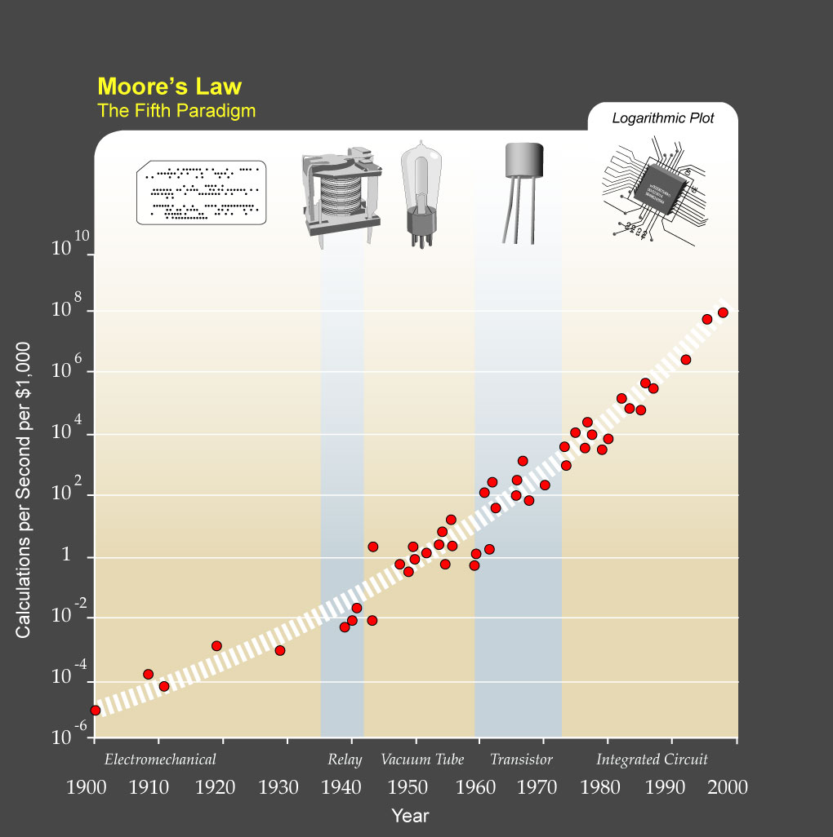
?
Major Technology Generations
CMOS
Bipolar
nMOS
Vacuum Tubes
pMOS
Relays
[from Kurzweil]
Electromechanical

Slide 11
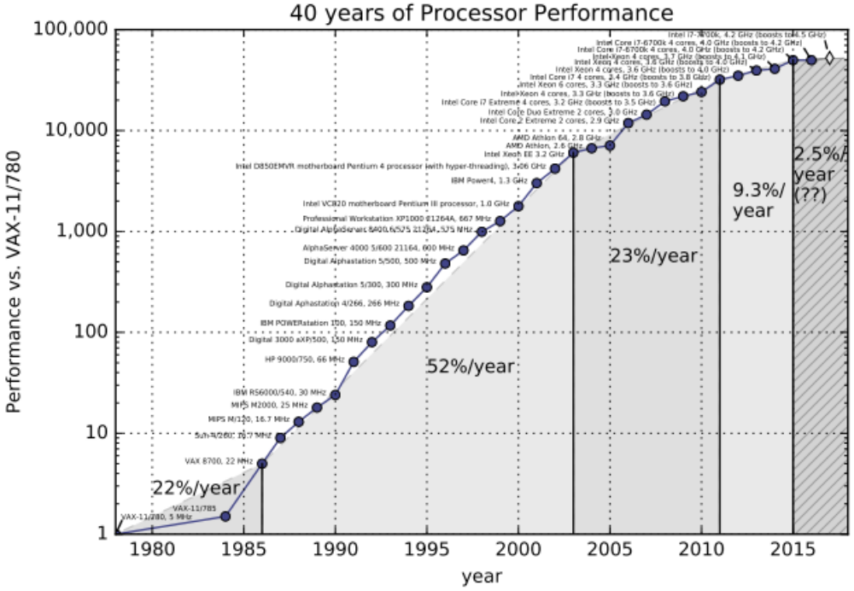
Single-Thread Processor Performance
[ Hennessy & Patterson, 2017 ]

Slide 12
Upheaval in Computer Design
Most of last 50 years, Moore’s Law ruled
  Technology scaling allowed continual performance/energy improvements without changing software model
Last decade, technology scaling slowed/stopped
  Dennard (voltage) scaling over (supply voltage ~fixed)
  Moore’s Law (cost/transistor) over?
  No competitive replacement for CMOS anytime soon
  Energy efficiency constrains everything
No “free lunch” for software developers, must consider:
  Parallel systems
  Heterogeneous systems

Slide 13
Today’s Dominant Target Systems
Mobile (smartphone/tablet)
  >1 billion sold/year
  Market dominated by ARM-ISA-compatible general-purpose processor in system-on-a-chip (SoC)
  Plus sea of custom accelerators (radio, image, video, graphics, audio, motion, location, security, etc.)
Warehouse-Scale Computers (WSCs)
  100,000’s cores per warehouse
  Market dominated by x86-compatible server chips
  Dedicated apps, plus cloud hosting of virtual machines
  Now seeing increasing use of GPUs, FPGAs, custom hardware to accelerate workloads
Embedded computing
  Wired/wireless network infrastructure, printers
  Consumer TV/Music/Games/Automotive/Camera/MP3
  Internet of Things!

Slide 14
A Simple RISC Processor
Basic Building Blocks

Slide 15
Hardware Elements
Combinational circuits
  Mux, Demux, ALU, ...
OpSelect
- Add, Sub, ...
- And, Or, Xor, Not, ...
- GT, LT, EQ, Zero, ...
Sel
Sel
lg(n)
lg(n)
O
A
A₀
A₁
A_{n-1}
.
O
De
Mux
.
Result
.
.
ALU
.
Mux
.
B
Comp?
Synchronous state elements
  Flipflop, Register, Register file, SRAM, DRAM
D
Clk
En
En
ff
Clk
D
Q
Q
Edge-triggered: Data is sampled at the rising edge

Slide 16
Register Files
register
D₀
D₁
D₂
...
D_{n-1}
En
...
Clk
ff
ff
ff
ff
Q₀
Q₁
Q₂
...
Q_{n-1}
Clock
WE
ReadSel1
rs1
we
rd1
ReadData1
ReadSel2
rs2
Register
file
2R+1W
rd2
ReadData2
WriteSel
ws
WriteData
wd
Reads are combinational

Slide 17
Register File Implementation
rd
clk
wdata
rs1
rdata1
rdata2
rs2
32
32
32
5
5
5
reg 0
we
reg 1
…
…
…
reg 31
  RISC-V integer instructions have at most 2 register source operands
Register files with a large number of ports are difficult to design
  Intel’s Itanium, GPR File has 128 registers with 8 read ports and 4 write ports to support 4 integer operations per cycle!!!

Slide 18
A Simple Memory Model
WriteEnable
Clock
Address
MAGIC
RAM
ReadData
WriteData
Reads and writes are always completed in one cycle
  a Read can be done any time (i.e. combinational)
  a Write is performed at the rising clock edge
  if it is enabled
  ⇒ the write address and data
  must be stable at the clock edge
Later in the course we will present a more realistic model of memory

Slide 19
Administrivia
Instructor: Yasir Javed, yasir.javed@abasyn.edu.pk
Text: Computer Architecture: A Quantitative Approach,
Hennessey and Patterson
Other Reference Material:
Computer organization and Design,The hardware/software interface, Patterson and Hennessey.
UC berkeley CS152 and CS252 course material
Videos are uploaded on Renzym Education channel. Go to playlist section and open computer architecture playlist
Youtube Link: www.youtube.com/renzymeducation
Notes:
This slide is for the 3-min class administrative matters.
Make sure we update Handout #1 so it is consistent with this slide.

Slide 20
CS152 Structure and Syllabus
Six modules
  Simple machine design (ISAs, microprogramming, unpipelined machines, Iron Law, simple pipelines)
  Memory hierarchy (DRAM, caches, optimizations) plus virtual memory systems, exceptions, interrupts
  Complex pipelining (score-boarding, out-of-order issue)
  Explicitly parallel processors (vector machines, VLIW machines, multithreaded machines)
  Multiprocessor architectures (memory models, cache coherence, synchronization)
  (If time allows) Multi-threading, Latency Tolerance, GPU, Power, Warehouse Scale Computing
Notes:
This is the 1st slide of the “Course Structure and Course Philosophy” section of the lecture.
Need to emphasis that for exams, our goal is the test your knowledge. It is not our goal to test how well your perform under time pressure.

Slide 21
Instruction Set Architecture (ISA)

Slide 22
RISC-V ISA
New RISC design from UC Berkeley
Realistic & complete ISA, but open & small
Not over-architected for a certain implementation style
Both 32-bit and 64-bit address space variants
  RV32 and RV64
Designed for multiprocessing
Efficient instruction encoding
Easy to subset/extend for education/research
We’ll be using 32-bit RISC-V this semester in lectures, very similar to MIPS

Slide 23
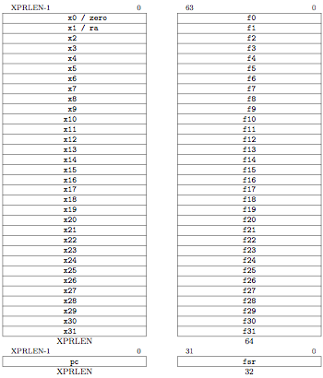
RV32 Processor State
Program counter (pc)
32x32-bit integer registers (x0-x31)
x0 always contains a 0
32 floating-point (FP) registers (f0-f31)
each can contain a single- or double-precision FP value (32-bit or 64-bit IEEE FP)
FP status register (fsr), used for FP rounding mode & exception reporting

Slide 24

RISC-V Instruction Formats
Reg. Source 2
Additional opcode bits/immediate
7-bit opcode field (but low 2 bits =11₂)
Destination Reg.
Reg. Source 1

Slide 25
R-Type/I-Type/R4-Type Formats
Reg-Reg ALU operations
Reg-Imm ALU operations
Load instructions, (rs1 + immediate) addressing
12-bit signed immediate
Only used for floating-point fused multiply-add
Reg. Source 3

Slide 26

B-Type
12-bit signed immediate split across two fields
Branches, compare two registers, PC+immediate target
(Branches do not have delay slot)
Store instructions, (rs1 + immediate) addressing, rs2 data

Slide 27

L-Type
Writes 20-bit immediate to top of destination register.
Used to build large immediates.
12-bit immediates are signed, so have to account for sign when building 32-bit immediates in 2-instruction sequence (LUI high-20b, ADDI low-12b)

Slide 28

J-Type
“J” Unconditional jump, PC+offset target
“JAL” Jump and link, also writes PC+4 to x1
Offset scaled by 1-bit left shift – can jump to 16-bit instruction boundary (Same for branches)

Slide 29
Implementing RISC-V:
Single-cycle per instruction datapath & control logic

Slide 30
Instruction Execution
Execution of an instruction involves
    1. instruction fetch
    2. decode and register fetch
    3. ALU operation
    4. memory operation (optional)
    5. write back
and the computation of the address of the
next instruction

Slide 31
Datapath: Reg-Reg ALU Instructions
RegWriteEn
0x4
Add
clk
Inst<26:22>
we
Inst<21:17>
rs1
PC
addr
rs2
inst
Inst<31:27>
rd1
ALU
wa
Inst.
Memory
wd
rd2
clk
GPRs
Inst<16:0>
ALU
Control
RegWrite Timing?
OpCode
5 5 5 10 7
rd rs1 rs2 func opcode rd ← (rs1) func (rs2)
31 27 26 22 21 17 16 7 6 0

Slide 32
Datapath: Reg-Imm ALU Instructions
RegWriteEn
0x4
Add
clk
inst<26:22>
we
rs1
addr
rs2
PC
inst
inst<31:27>
wa
rd1
ALU
Inst.
Memory
wd
rd2
clk
GPRs
inst<21:10>
Imm
Select
inst<9:0>
ALU
Control
OpCode
ImmSel
5 5 12 3 7
rd rs1 immediate12 func opcode rd ← (rs1) op immediate
31 27 26 22 21 10 9 7 6 0

Slide 33
Conflicts in Merging Datapath
RegWrite
Introduce
muxes
0x4
Add
clk
inst<26:22>
we
Inst<21:17>
rs1
addr
rs2
PC
inst
Inst<31:27>
wa
rd1
ALU
Inst.
Memory
wd
rd2
clk
GPRs
Inst<21:10>
Imm
Select
Inst<16:0>
ALU
Control
Inst<9:0>
OpCode
ImmSel
5 5 5 10 7
rd rs1 rs2 func10 opcode rd ← (rs1) func (rs2)
rd rs1 immediate12 func3 opcode rd ← (rs1) op immediate

Slide 34
Datapath for ALU Instructions
0x4
RegWriteEn
Add
clk
<26:22>
we
<21:17>
rs1
addr
rs2
PC
inst
<31:27>
wa
rd1
ALU
Inst.
Memory
wd
rd2
clk
GPRs
Imm
Select
<16:0>
ALU
Control
<6:0>
OpCode
ImmSel
FuncSel
Op2Sel
Reg / Imm
5 5 5 10 7
rd rs1 rs2 func10 opcode rd ← (rs1) func (rs2)
rd rs1 immediate12 func3 opcode rd ← (rs1) op immediate

Slide 35
Load/Store Instructions
RegWriteEn
MemWrite
0x4
clk
WBSel
ALU / Mem
Add
we
“base”
rs1
clk
rs2
PC
addr
rd1
we
inst
wa
ALU
addr
wd
rd2
Inst.
Memory
GPRs
rdata
clk
Data
Memory
disp
Imm
Select
wdata
ALU
Control
OpCode
ImmSel
FuncSel
Op2Sel
5 5 5 7 3 7 Addressing Mode
imm rs1 rs2 imm func3 opcode Store (rs) + displacement
rd rs1 immediate12 func3 opcode Load
rs1 is the base register
rd is the destination of a Load, rs2 is the data source for a Store

Slide 36
RISC-V Conditional Branches
BEQ/BNE
BLT/BGE
BLTU/BGEU
5
5
5
7
3
7
imm[11:7]
rs1
rs2
imm[6:0]
func3
opcode
31
27
26
22
21
17
16
10
9
7
6
0
Compare two integer registers for equality (BEQ/BNE) or signed magnitude (BLT/BGE) or unsigned magnitude (BLTU/BGEU)
12-bit immediate encodes branch target address as a signed offset from PC, in units of 16-bits (i.e., shift left by 1 then add to PC).

Slide 37
Conditional Branches (BEQ/BNE/BLT/BGE/BLTU/BGEU)
PCSel
RegWrEn
br
MemWrite
WBSel
pc+4
0x4
Add
Add
clk
we
Br Logic
Bcomp?
rs1
clk
addr
rs2
PC
inst
rd1
we
wa
ALU
addr
Inst.
Memory
wd
rd2
clk
GPRs
rdata
Data
Memory
Imm
Select
wdata
ALU
Control
OpCode
ImmSel
FuncSel
Op2Sel

Slide 38
RISC-V Unconditional Jumps
25
7
J
JAL
Jump Offset[24:0]
opcode
31
7
6
0
25-bit immediate encodes jump target address as a signed offset from PC, in units of 16-bits (i.e., shift left by 1 then add to PC). (+/- 16MB)
JAL is a subroutine call that also saves return address (PC+4) in register x1

Slide 39
RISC-V Register Indirect Jumps
5
5
12
3
7
JALR
RDNPC
rd
rs1
Imm[11:0]
func3
opcode
31
27
26
22
21
10
9
7
6
0
Jumps to target address given by adding 12-bit offset (not shifted by 1 bit) to register rs1
The return address (PC+4) is written to rd (can be x0 if value not needed)
The RDNPC instruction simply writes return address to register rd without jumping (used for dynamic linking)

Slide 40
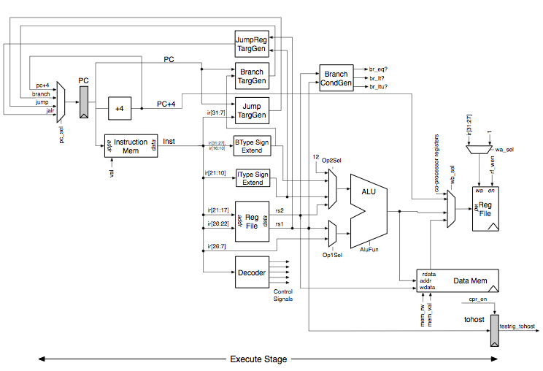
Full RISCV1Stage Datapath (Lab1)

Slide 41
Hardwired Control is pure Combinational Logic
combinational
logic
ImmSel
Op2Sel
FuncSel
op code
MemWrite
WBSel
Equal?
WASel
RegWriteEn
PCSel

Slide 42
ALU Control & Immediate Extension
Inst<16:7> (Func)
Inst<6:0> (Opcode)
ALUop
+
0?
FuncSel
( Func, Op, +, 0? )
Decode Map
ImmSel
( IType₁₂, BsType₁₂,
BrType₁₂)

Slide 43
Hardwired Control Table
Opcode | ImmSel | Op2Sel | FuncSel | MemWr | RFWen | WBSel | WASel | PCSel
ALU
ALUi
LW
SW
BEQ_{true}
BEQ_{false}
J
JAL
JALR
*
Reg
Func
no
yes
ALU
rd
pc+4
IType₁₂
Imm
Op
no
yes
ALU
rd
pc+4
IType₁₂
Imm
+
no
yes
Mem
rd
pc+4
BsType₁₂
Imm
+
yes
no
*
*
pc+4
BrType₁₂
*
*
no
no
*
*
br
BrType₁₂
*
*
no
no
*
*
pc+4
*
*
*
no
no
*
*
jabs
*
*
*
no
yes
PC
X1
jabs
*
*
*
no
yes
PC
rd
rind
Op2Sel= Reg / Imm WBSel = ALU / Mem / PC
WASel = rd / X1 PCSel = pc+4 / br / rind / jabs

Slide 44
Single-Cycle Hardwired Control:
Harvard architecture
We will assume
  clock period is sufficiently long for all of
  the following steps to be “completed”:
      1. instruction fetch
      2. decode and register fetch
      3. ALU operation
      4. data fetch if required
      5. register write-back setup time
        ⇒ t_{C} > t_{IFetch} + t_{RFetch} + t_{ALU}+ t_{DMem}+ t_{RWB}
  At the rising edge of the following clock, the PC,
  the register file and the memory are updated

Slide 45
Increasing Processor Clock Speed
Pipeling RISC-V

Slide 46
An Ideal Pipeline
stage
1
stage
2
stage
3
stage
4
All objects go through the same stages
No sharing of resources between any two stages
Propagation delay through all pipeline stages is equal
The scheduling of an object entering the pipeline
is not affected by the objects in other stages
These conditions generally hold for industrial assembly lines, but instructions depend on each other!

Slide 47
Pipelined RISC-V
To pipeline RISC-V:
First build RISC-V without pipelining with CPI=1
Next, add pipeline registers to reduce cycle time while maintaining CPI=1

Slide 48
Unpipelined Datapath for RISC-V
PCSel
RegWriteEn
MemWrite
WBSel
br
rind
jabs
pc+4
0x4
Add
Add
clk
we
Br Logic
Bcomp?
rs1
clk
addr
1
rs2
PC
inst
rd1
we
wa
ALU
addr
Inst.
Memory
wd
rd2
clk
GPRs
rdata
Data
Memory
Imm
Select
wdata
ALU
Control
OpCode
WASel
ImmSel
FuncSel
Op2Sel

Slide 49
Hardwired Control Table
Opcode | ImmSel | Op2Sel | FuncSel | MemWr | RFWen | WBSel | WASel | PCSel
ALU
ALUi
LW
SW
BEQ_{true}
BEQ_{false}
J
JAL
JALR
*
Reg
Func
no
yes
ALU
rd
pc+4
IType₁₂
Imm
Op
no
yes
ALU
rd
pc+4
IType₁₂
Imm
+
no
yes
Mem
rd
pc+4
BsType₁₂
Imm
+
yes
no
*
*
pc+4
BrType₁₂
*
*
no
no
*
*
br
BrType₁₂
*
*
no
no
*
*
pc+4
*
*
*
no
no
*
*
jabs
*
*
*
no
yes
PC
X1
jabs
*
*
*
no
yes
PC
rd
rind
Op2Sel= Reg / Imm WBSel = ALU / Mem / PC
WASel = rd / X1 PCSel = pc+4 / br / rind / jabs

Slide 50
Pipelined Datapath
0x4
Add
we
rs1
rs2
PC
addr
rd1
we
rdata
IR
wa
ALU
addr
wd
rd2
GPRs
rdata
Inst.
Memory
Data
Memory
Imm
Select
wdata
write
-back
phase
fetch
phase
decode & Reg-fetch
phase
execute
phase
memory
phase
Clock period can be reduced by dividing the execution of an instruction into multiple cycles
t_{C} > max {t_{IM}, t_{RF}, t_{ALU}, t_{DM}, t_{RW}} ( = t_{DM} probably)
However, CPI will increase unless instructions are pipelined

Slide 51
“Iron Law” of Processor Performance
Time = Instructions Cycles Time
Program Program * Instruction * Cycle
Instructions per program depends on source code, compiler technology, and ISA
Cycles per instructions (CPI) depends upon the ISA and the microarchitecture
Time per cycle depends upon the microarchitecture and the base technology
Microarchitecture | CPI | cycle time
Microcoded | >1 | short
Single-cycle unpipelined | 1 | long
Pipelined | 1 | short

Slide 52
CPI Examples
Microcoded machine
Time
7 cycles
5 cycles
10 cycles
Inst 1
Inst 2
Inst 3
3 instructions, 22 cycles, CPI=7.33
Unpipelined machine
Inst 1
Inst 2
Inst 3
3 instructions, 3 cycles, CPI=1
Pipelined machine
Inst 1
3 instructions, 3 cycles, CPI=1
Inst 2
Inst 3
5-stage pipeline CPI≠5!!!

Slide 53
Technology Assumptions
A small amount of very fast memory (caches)
backed up by a large, slower memory
Fast ALU (at least for integers)
Multiported Register files (slower!)
Thus, the following timing assumption is reasonable
t_{IM} ≈ t_{RF} ≈ t_{ALU} ≈ t_{DM} ≈ t_{RW}
A 5-stage pipeline will be the focus of our detailed design
- some commercial designs have over 30 pipeline stages to do an integer add!

Slide 54
5-Stage Pipelined Execution
0x4
Add
we
rs1
rs2
rd1
PC
addr
IR
wa
we
rdata
wd
rd2
ALU
addr
GPRs
rdata
Inst.
Memory
Data
Memory
Imm
Select
wdata
Write
-Back (WB)
I-Fetch (IF)
Decode, Reg. Fetch (ID)
Execute (EX)
Memory (MA)
time t0 t1 t2 t3 t4 t5 t6 t7 . . . .
instruction1 IF₁ ID₁ EX₁ MA₁ WB₁
instruction2 IF₂ ID₂ EX₂ MA₂ WB₂
instruction3 IF₃ ID₃ EX₃ MA₃ WB₃
instruction4 IF₄ ID₄ EX₄ MA₄ WB₄
instruction5 IF₅ ID₅ EX₅ MA₅ WB₅

Slide 55
5-Stage Pipelined Execution
Resource Usage Diagram
0x4
Add
we
rs1
rs2
rd1
PC
addr
IR
ws
we
rdata
wd
rd2
ALU
addr
GPRs
rdata
Inst.
Memory
Data
Memory
Imm
Select
wdata
Write
-Back (WB)
I-Fetch (IF)
Decode, Reg. Fetch (ID)
Execute (EX)
Memory (MA)
time t0 t1 t2 t3 t4 t5 t6 t7 . . . .
IF I₁ I₂ I₃ I₄ I₅
ID I₁ I₂ I₃ I₄ I₅
EX I₁ I₂ I₃ I₄ I₅
MA I₁ I₂ I₃ I₄ I₅
WB I₁ I₂ I₃ I₄ I₅
Resources

Slide 56
Pipelined Execution:
ALU Instructions
0x4
IR
IR
IR
Add
1
we
rs1
addr
rs2
A
PC
wa
rd1
we
inst
IR
wd
rd2
ALU
Y
addr
Inst
Memory
GPRs
B
rdata
Data
Memory
R
Imm
Select
wdata
wdata
MD1
MD2
Not quite correct!
We need an Instruction Reg (IR) for each stage

Slide 57
Acknowledgements
These slides contain material developed and copyright by:
  Arvind (MIT)
  Krste Asanovic (MIT/UCB)
  Joel Emer (Intel/MIT)
  James Hoe (CMU)
  John Kubiatowicz (UCB)
  David Patterson (UCB)
MIT material derived from course 6.823
UCB material derived from course CS252

